Slide 1
Constructor and Destructor

Slide 2
Constructors
A constructor is a special type of subroutine called at the creation of an object. A constructor method are invoked before an object of it's associated class is created. If a class have a constructor, then the object of that class will be initialized automatically. A constructor looks like an instance method, but it different from a method because it never has an explicit return-type, and can be overridden to provide custom initialization functionality. They have the task of initializing the object's data members. If you combine a constructor that initializes an object to a valid state and property methods that only allow valid states, your objects should remain in a valid state. In Visual Basic we create constructors by adding a Sub procedure named New to a class.
The following code show you the use of constructor in Visual Basic .NET:

Slide 3
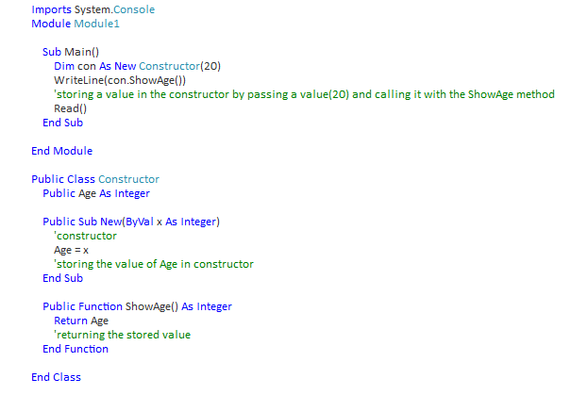

Slide 4
Destructors
The destructor is the last method run by a class. Destructors in Visual Basic .NET are implemented as a protected method named Finalize. The garbage collector will call your Finalize method if you implement one, but you won't know when that will be you can't invoke this method directly. Finalize method can not overloaded by convention but must be overridden if you are going to introduce your own code in this routine by using Overrides keyword in your declaration. Finalize method invoke automatically when the object is no longer required. The main work of the destructor is release resources and inform other objects that the current objects are going to be destroyed.
The following code show you the use of Destructor in Visual Basic .NET:

Slide 5
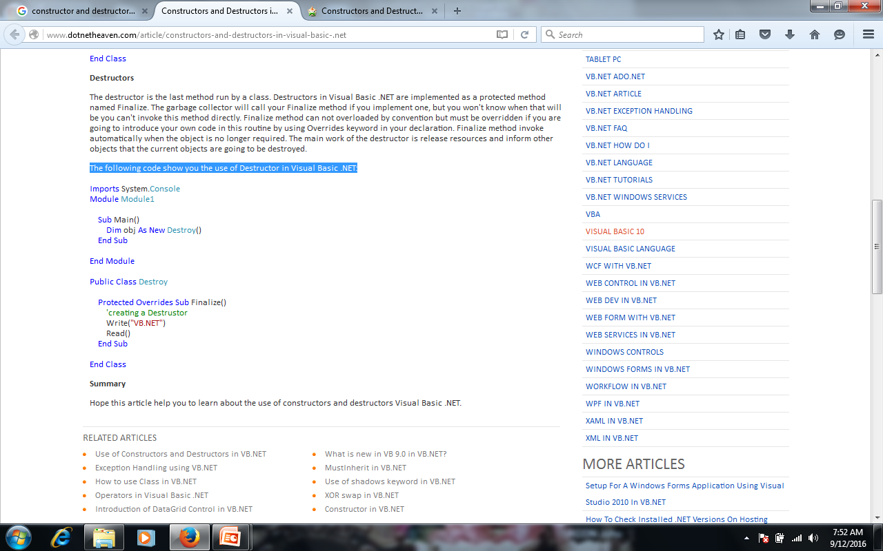

Slide 6
Use of Constructor and Destructor
In this article we will learn about constructor and destructor in VB.NET.
Constructors: Special methods which has following important points.
In VB.NET, this is defined as a Sub with the name of New.
No return type.
It's called whenever an object is created using the New statement.
Can be overloaded.
Can be private.
Destructors: Special methods Which has The following important points.
This is called Finalize in VB.NET.
VB.NET compiler creates a default Finalize method.
Can never be private.
By default is public.
Called automatically when an object releases it memory.

